Slide 1
基于隐私保护的分布式计算 Privacy-preserving distributed processing over networks
李琼秀 2021/11/30
华为2021实验室&清华大学

Slide 2
1. 个人介绍

Slide 3
教育经历
中国-东北大学 （秦皇岛），本科 电子信息工程 2011年9月-2015年6月
GPA 91.97/100 (综合排名:1/145)
国家级奖学金，国家励志奖学金，省三好学生，省级数学竞赛一等奖等
韩国-仁荷大学， 硕士 信息与通信工程 2015年9月-2017年6月
GPA:98.63/100 (荣誉学生)， 导师: Hakil Kim（韩国）
全额奖学金 (学费 + 生活费) 大学招生中国宣传大使
丹麦-奥尔堡大学，博士 信息与通信工程 2018年3月-2021年8月
(2021年USNews世界工程学排名-No.6)
导师: Prof.Mads Græsbøll Christensen（丹麦-奥尔堡大学）
Prof.Richard Heusdens（荷兰-代尔夫特理工大学）
研究方向: 分布式信号的安全处理，分布式优化，无线传感器网络，隐私和安全
荷兰-代尔夫特理工大学，访问博士 信息与通信工程 2019年9月-2019年12月
研究方向: 图信号的安全处理，分布式优化

Slide 4
工作经历
奥尔堡大学&普林斯顿大学 联合博士后 2021年9月-2021年11月
（因为想回国，提前终止了三年海外联合博后合同）
华为&清华大学 联合博士后 2021年11月-至今

Slide 5
报告&教学经历
邀请报告
隐私保护分布式优化（硕博士课程） 荷兰-代尔夫特理工大学 2021年3月
分布式优化的前沿技术探讨（博士课程） 丹麦-奥尔堡大学 2018年11月
教学经验（Lecturer & Teaching Assistant）
机器学习基础（硕士课程） 丹麦-奥尔堡大学 2018-2020 秋季学期
语音信号处理实践课（本科课程） 丹麦-奥尔堡大学2019-2021 春季学期

Slide 6
博士期间出版物（2018.3-2021.8）
Q. Li, I. Cascudo, and M. G. Christensen, “Privacy-Preserving Distributed Average Consensus based on Additive Secret Sharing,” in Proc. Eur. Signal Process. Conf., pp. 1-5, 2019.
Q. Li, and M. G. Christensen, “A Privacy-Preserving Asynchronous Averaging Algorithm based on Shamir’s Secret Sharing,” in Proc. Eur. Signal Process. Conf., pp. 1-5, 2019.
Q. Li, R. Heusdens, and M. G. Christensen, “Convex Optimisation-based Privacy-Preserving Distributed Average Consensus in Wireless Sensor Networks,” in Proc. Int. Conf. Acoust., Speech, Signal Process., pp. 5895-5899, 2020.
Q. Li, R. Heusdens, and M. G. Christensen, “Convex Optimization-based Privacy-Preserving Distributed Least Squares via Subspace Perturbation,” in Proc. Eur. Signal Process. Conf., pp. 2110-2114, 2021.
Q. Li, M. Coutino, G. Leus and M. G. Christensen, “Privacy-Preserving Distributed Graph Filtering,” in Proc. Eur. Signal Process. Conf., pp. 2155-2159, 2021.
Q. Li, R. Heusdens, and M. G. Christensen, “Privacy-Preserving Distributed Optimization via Subspace Perturbation: A General Framework,” in IEEE Trans. Signal Process., vol. 68, pp. 5983 - 5996, 2020.
Q. Li, J.S. Gundersen, R. Heusdens, and M. G. Christensen, “Privacy-Preserving Distributed Processing: Metrics, Bounds, and Algorithms,” in IEEE Trans. Inf. Forensics Security., 2021.
Q. Li, R. Heusdens, and M. G. Christensen, “Communication Efficient Privacy-Preserving Distributed Optimization using Adaptive Quantization,” in Signal Processing (major revision), 2021.

Slide 7
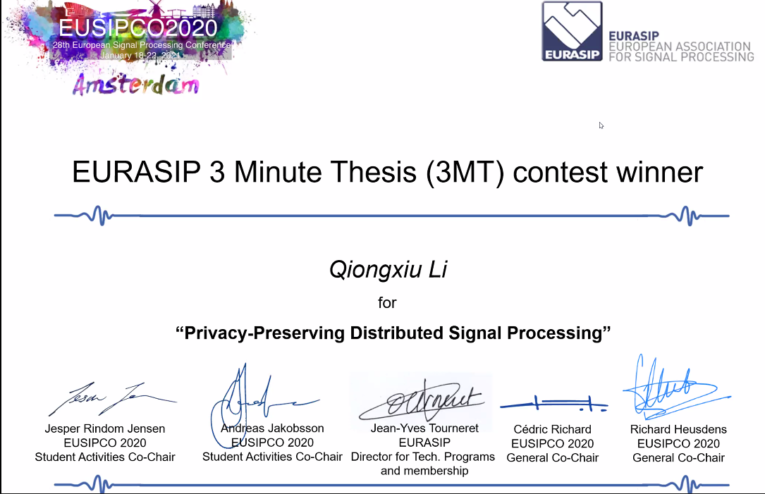
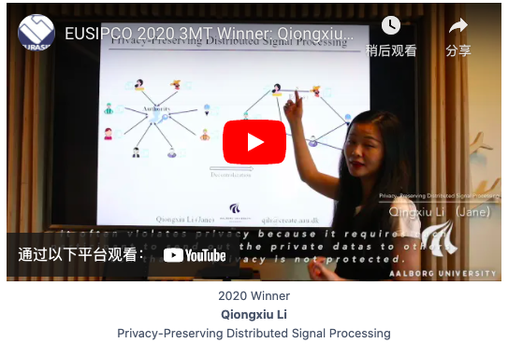
荣获奖项
EUSIPCO 2020（欧洲信号处理协会-旗舰会议）
3MT博士论文答辩比赛 冠军
李琼秀 分布式隐私保护信号处理
Notes:
Collaborations make superior performance

Slide 8
2. 基于隐私保护的分布式计算

Slide 9

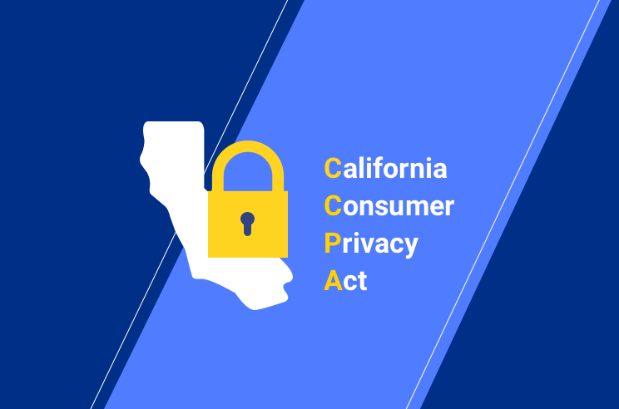

Privacy regulations everywhere

Slide 10



General perception of privacy-sensitive data
Identity
Address
Health record

Slide 11
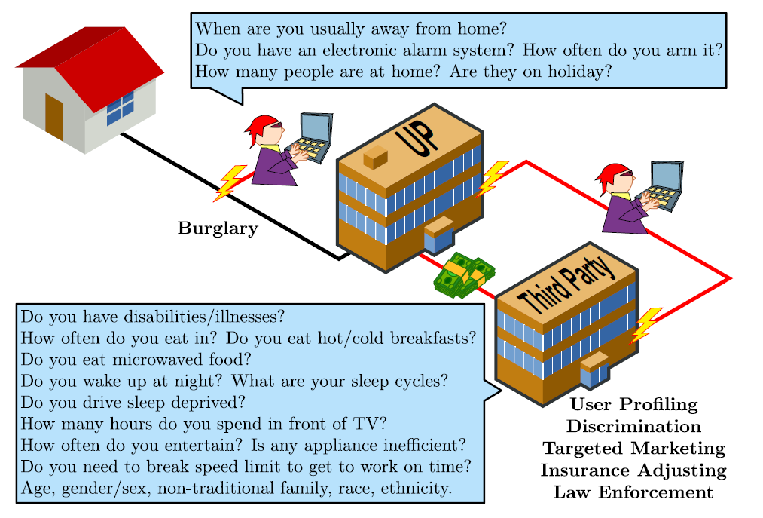
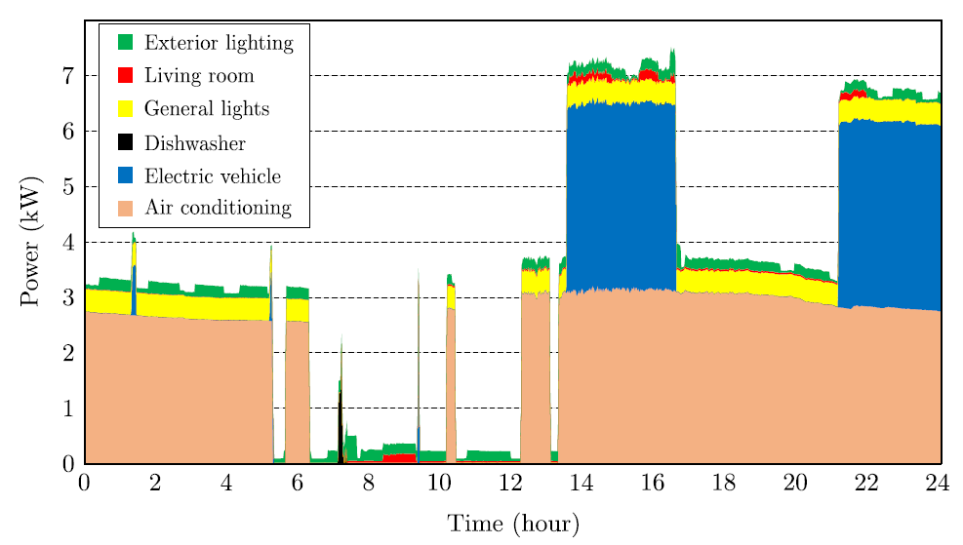
However ….
No real separation between your data and your identity [Sarwate, 2013].
Privacy issue in smart meters [Giaconi, 2018]

Slide 12










Why distributed?
Centralized system v.s. Distributed system
Authority
☹ Totally dependent on the authority
☹ Vulnerable to malicious attack
No dependency on any single party
More flexible system
Robust to malicious attack

Slide 13








Privacy-preserving distributed processing
Applications
Health care
Contact tracing
IOT& wireless sensor networks
https://www.kaspersky.com/about/policy-blog/industrial-cybersecurity/security-of-internet-of-things-iot
Notes:
Collaborations make superior performance

Slide 14
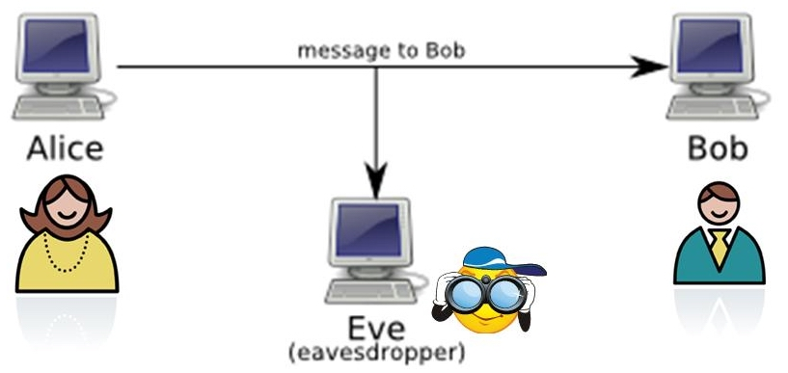
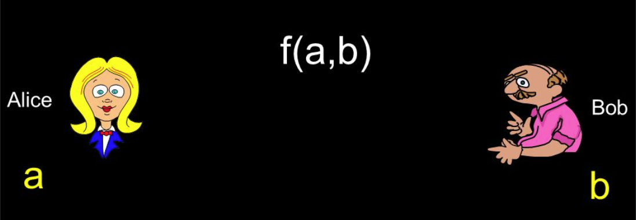
Important distinction
Secure communication v.s. secure computation
Secure communication v.s. secure computation
Secure communication
Only message passing
No computation based on message
Alice trusts Bob
Secure computation
Computation based on message
No trust

Slide 15
3. Problem formulation

Slide 16
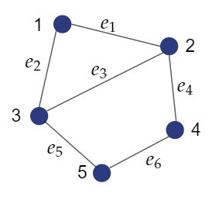
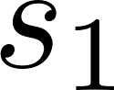
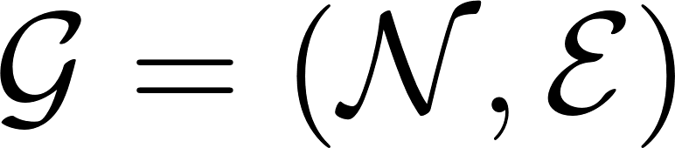
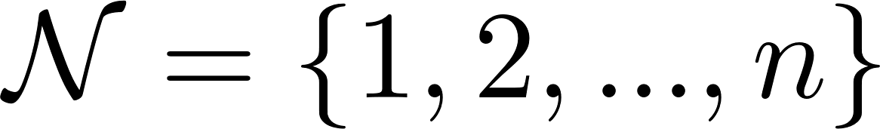
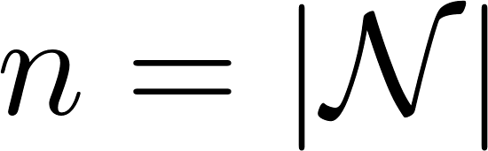
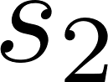
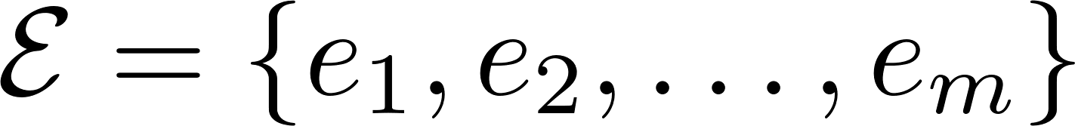
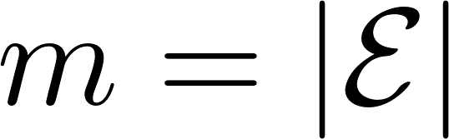
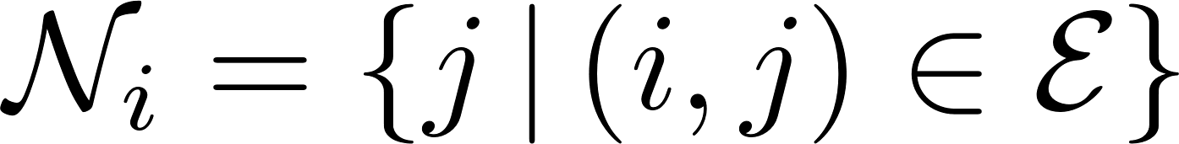
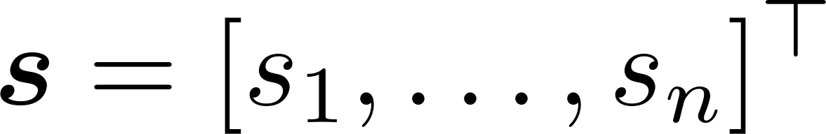
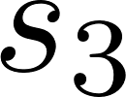
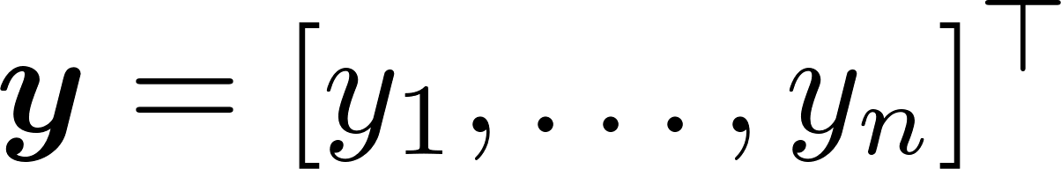
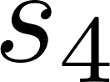
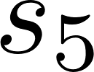
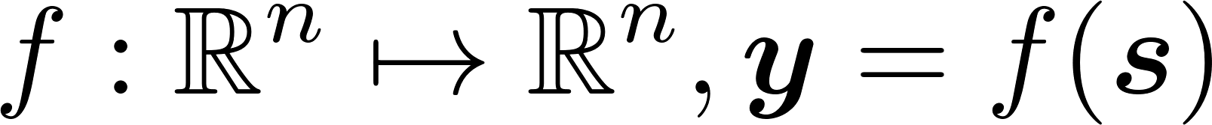
Privacy-preserving distributed processing over networks
All nodes jointly compute a function
over their private date in a distributed manner without violating privacy.
Output correctness: how accurate is the function output compared to non-privacy-preserving counterparts
Individual privacy: the private data of honest nodes should be protected from revealing to the adversaries.

Slide 17




Adversary model
Eavesdropping adversary
eavesdrops all channels between nodes
assume secure channel encryption
(expensive for iterative algorithm)
Corrupted nodes
Honest nodes
Passive (or semi-honest, honest-but-courious) adversary
a number of corrupted nodes follow the protocol but share
information together to infer the private data of honest nodes

Slide 18
4. Existing approaches

Slide 19
Overview of exisiting approaches
Privacy-preserving computation tools
Hardware
Software
Information theoretic security
Trusted execution environment
Computational security
Homomorphic encryption
Secret
sharing
Differential privacy
Distributed signal processing over network

Slide 20
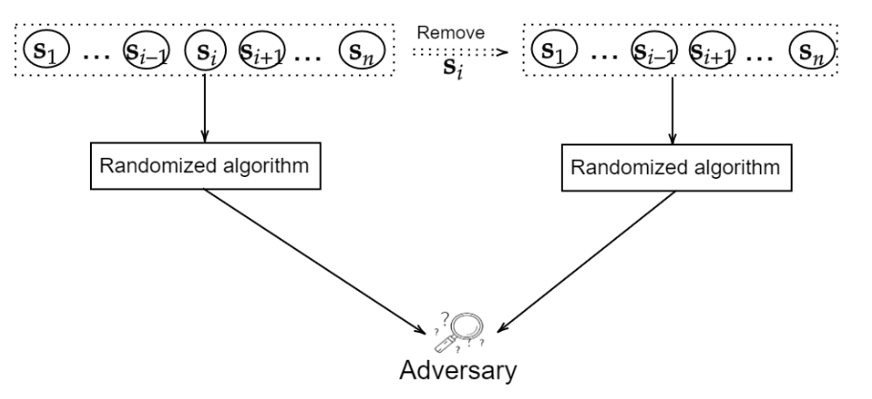
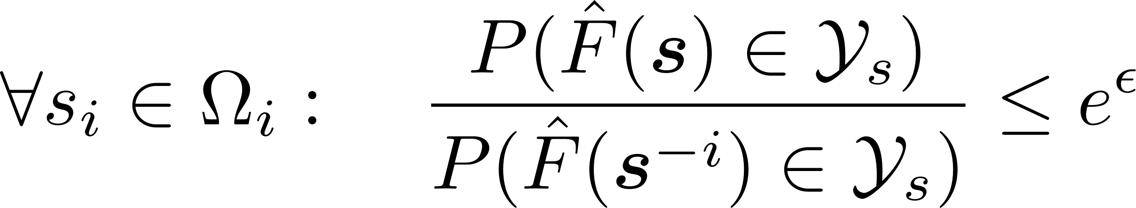

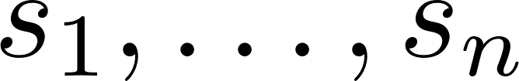
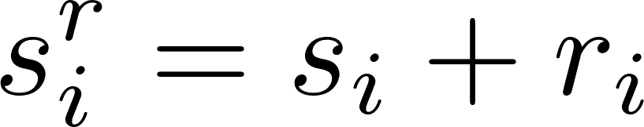
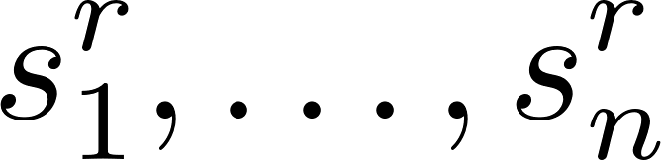
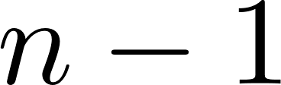
Differential privacy based approaches
Main idea of differential privacy [Dwork, 2006]
Posterior
Prior
Differential privacy + distributed signal processing [Huang, 2015] [Nozari, 2018 ]
Data masking
by inserting noise
☺ Simple and general
Individual privacy
No secure channel encrytion (eavesdropping adversary)
☺ Secure against corrupted nodes
(passive adversary)
Output correctness
(traded by individual privacy)
Differential privacy
Distributed signal processing
Notes:
The most famous real-world example of the global model is probably the US Census. In 2020, the US Census will use differential privacy to anonymize the data before publication.

Slide 21
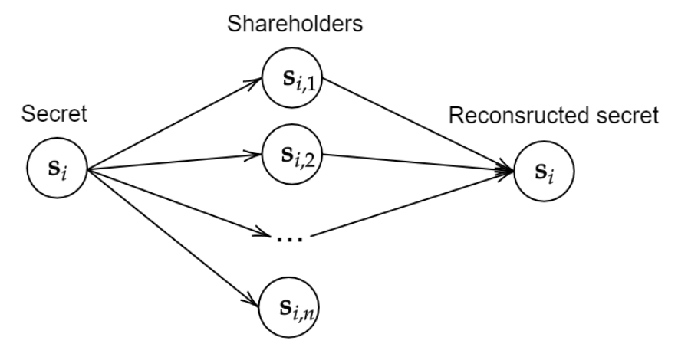


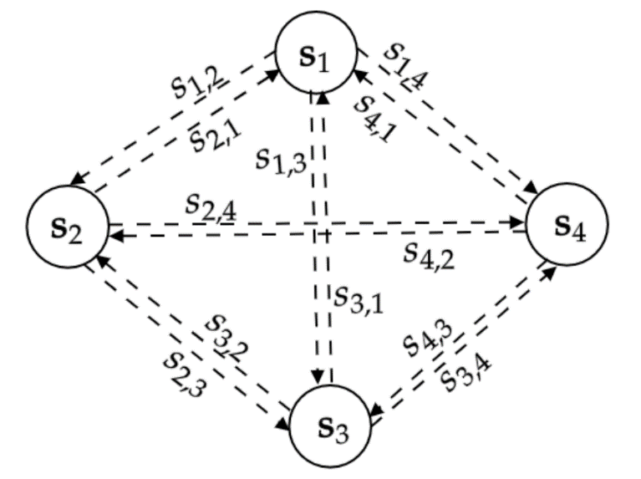
Secret sharing based approaches
Main idea of secret sharing [Cramer, 2015]
Secret sharing + distributed signal processing [Tjell 2019][Tjell 2020]
Output correctness
no privacy-accuracy trade-off
☹ Individual privacy
☹ Secure channel encrytion at all iterations
(eavesdropping adversary)
☹ Require at least one honest neighboring node
(passive adversary)
Communication expensive
Often require fully-connected graphs
(except specific applications like average or summation
Appply secret shairng at every iteration

Slide 22
5. Proposed approaches

Slide 23
Limitations of existing algorithms for general problems
Differential privacy algorithms:
privacy-accuracy trade-off
Secret sharing approaches:
communcationally expensive
fully-connected graph assumption

Slide 24
Explore the nature of distributed tools for privacy-preservation
Publication: Q. Li, R. Heusdens, and M. G. Christensen, “Privacy-Preserving Distributed Optimization via Subspace Perturbation: A General Framework,” in IEEE Trans. Signal Process., vol. 68, pp. 5983 - 5996, 2020.
Contributions:
A novel privacy-preserving approach derived on distributed optimization: subspace perturbation (DOSP)
Address the limitations of existing approaches

Slide 25
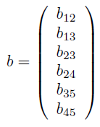
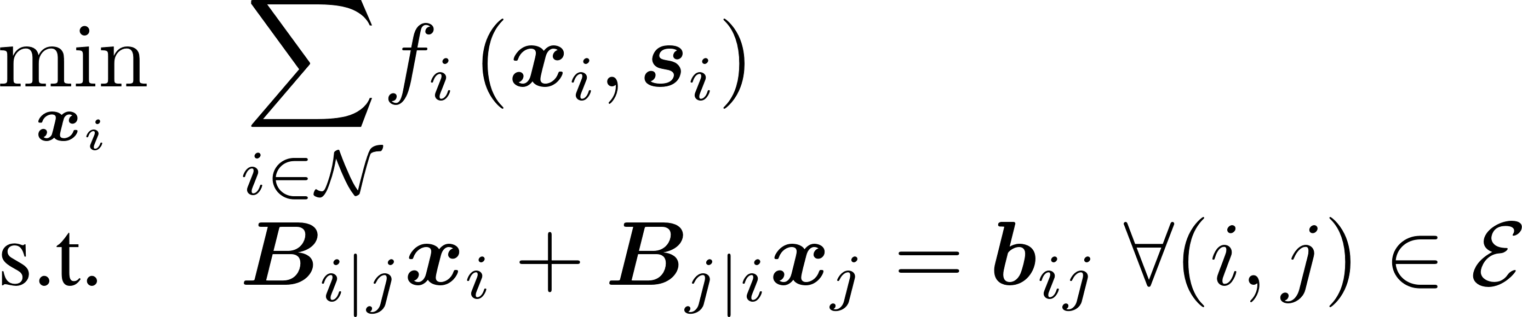
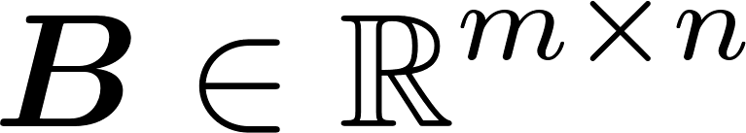

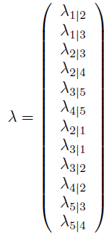
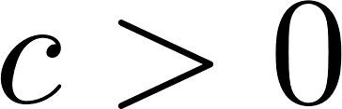
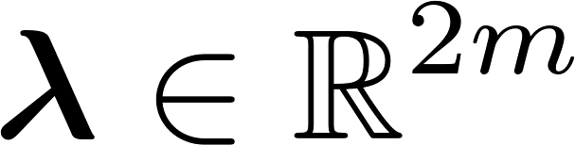
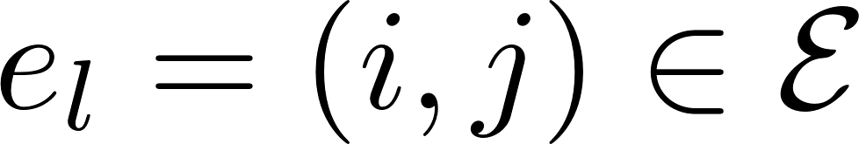
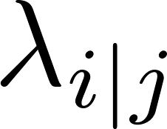

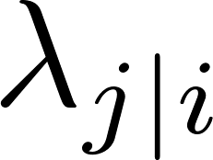

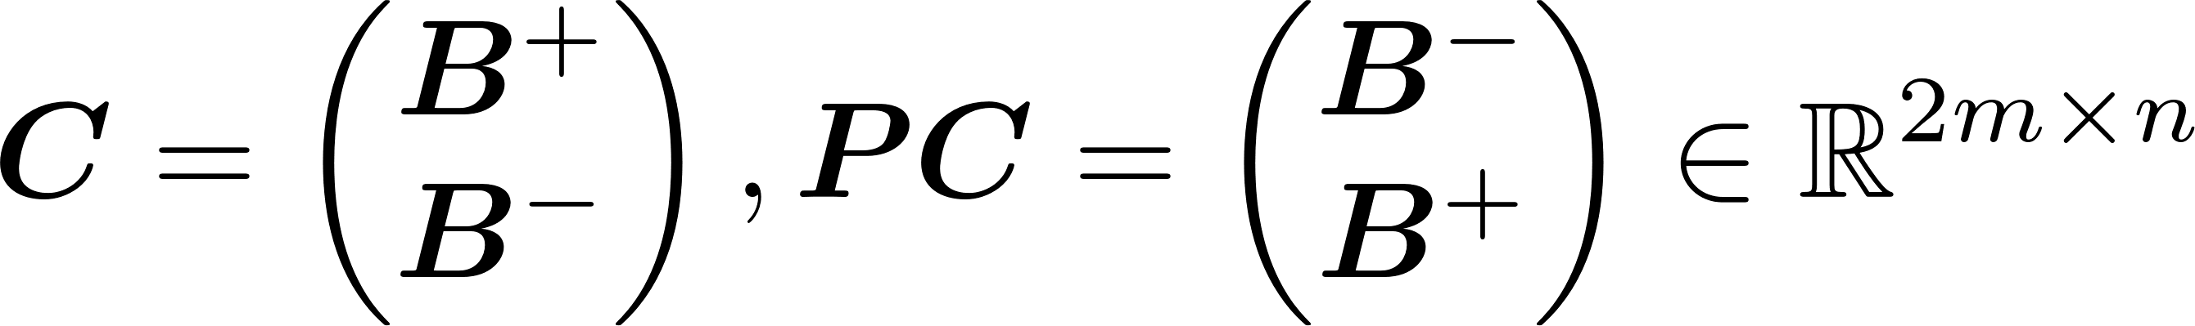
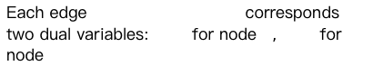
Distributed optimization over a network
Incidence matrix:
Extended augmented Lagrangian of PDMM [Sherson, 2018]
: constant for controlling convergence rate
: dual variables for constraints
Each edge corresponds two dual variables: for node $,$ for node

Slide 26


Motivation of the proposed approach
x-update of PDMM
contains private information
Motivation:
Instead of inserting additional noise, why not exploit the dual variable as noise?

Slide 27


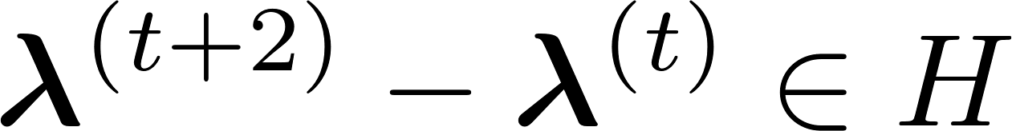

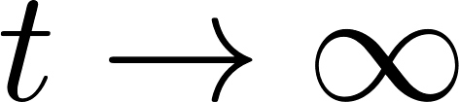

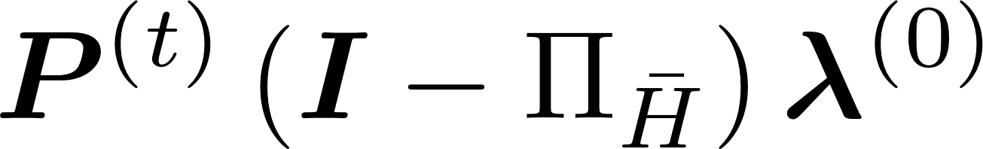
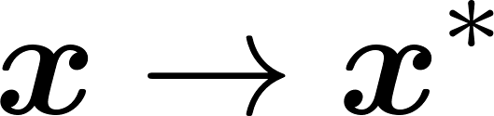
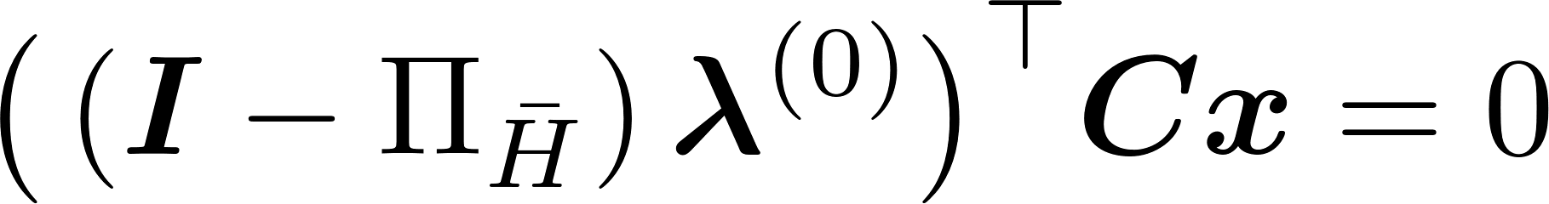
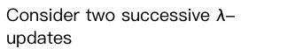
Convergence behavior of dual variable
Consider two successive $λ$-updates
converge
Only be permuted at every iteration
Subspace noise
Non-convegence property will not affect the accuracy:
since

Slide 28
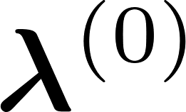
Performances
☺ Communication lightweight and do not require fully-connected graphs
☺ General applicable to various optimizers: dual ascent and ADMM [Boyd, 2011]
☺ Output correctness: no privacy-accuracy trade-off
☺ Individual privacy
☺ Eavesdropping adversary: only one time channel encryption for transmitting
☹ Passive adversary: at least one honest neighboring node

Slide 29
So far…
Information-theoretic privacy-preserving solutions
Secret sharing
Differential privacy
Distributed optimization based subspace perturbation
Which algorithm is the best?
How do they relate to each other?

Slide 30
Connecting the dots
Paper H: Q. Li, J.S. Gundersen, R. Heusdens, and M. G. Christensen, “Privacy-Preserving Distributed Processing: Metrics, Bounds, and Algorithms,” in IEEE Trans. Inf. Forensics Security., vol. 16, pp. 2090-2103, 2021.
Contributions:
Propose general metrics to quantify output utility and individual privacy for privacy-preserving distributed processing algorithms
Compare and relate exisiting algorithms using a concrete example
Provide insights and suggestions on how to design a proper algorithm

Slide 31
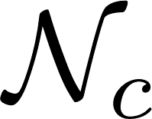
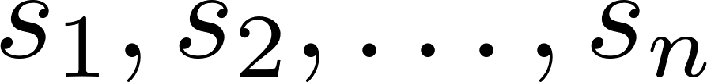






Proposed metrics for individual privacy and output utility
: Set of corrupted nodes
inputs
Privacy-preserving distributed processing algorithms
outputs
?
Individual privacy
Lower bound on individual privacy
Output utility

Slide 32









Secure multiparty computation (SMPC) [Cramer, 2015]
perfect
SMPC protocols
inputs
Trusted third party
outputs
Interpret SMPC using the proposed metrics
Perfect SMPC
Individual privacy
Output utility (perfect)

Slide 33





Differential privacy (DP)
Mutual information seen as a relaxed form of differential privacy [Cuff, 2016]
Posterior
Prior
Interpret DP using the proposed metrics
-differentially private distributed processing algorithms
Individual privacy ( corruptions)
Output utility (often compromised)

Slide 34




Comparisons (theoretical results + numerical validation)
Information-theoretical privacy-preserving distributed average consensus
NMI: Normalized mutual information

Slide 35



Which one is the best & how design a proper algorithm?
Check lower bound on individual privacy under perfect output utility and corruptions
For applications with
The optimum algorithm does not exist
Choose the algorithm based on priority (available assumptions)
For applications with
If tolerable, try SMPC or DOSP
If not, lower the output utility or number of corruptions to trade a better bound, try DP+SMPC/DOSP

Slide 36
6. Conclusions

Slide 37
Conclusions
Combine cryptographic techniques with distributed processing algorithms have been investigated
New privacy-preserving approaches based on distributed signal processing tools have been proposed
General metrics to relate and compare several existing information-theoretical approaches have been proposed
No universally optimum solution for all problems
Insights on how to design a proper algorithm have been provided

Slide 38
7. Future work

Slide 39
Future work
Quantization + SMPC or differential privacy approaches
Hybrid approaches, e.g., Subspace perturbation + differential privacy
Tighter lower bound on individual privacy by considering graph topology
Privacy-preserving graph signal processing
Applications in rivacy-preserving distributed learning

Slide 40




Ideal v.s. Real v.s. Actual
SMPC: Ideal world
SMPC: Real world
Actual world
We need a tighter lower bound in distributed networks !!!

Slide 41

Q&A

